Slide 1

The One Inefficiency No One Talks About in Indian Startups –
Knowledge Mismanagement
by Vidhu Jha

Slide 2
The Silent Productivity Tax
Indian startups lose $1.5B annually (McKinsey’s "India’s Tech Ecosystem: Growth and Challenges", 2023) due to an invisible inefficiency no pitch deck mentions: poor knowledge management (KM).
We obsess over ‘burn rates’ and ‘attrition,’ but ignore the 20-30% productivity drain (NASSCOM Survey, 2023) caused by loss of tribal knowledge and undocumented decisions.
This isn’t an ‘ops problem’ - it’s an existential risk. Startups that systemize knowledge scale faster, while others bleed capital relearning old lessons.
Example: Razorpay’s Engineering team, in 2023, launched their AI-powered internal wiki “RazorDocs”, leading to: (i) Reduction in onboarding time by 65% (ii) Search time for critical info dropped from 35 mins to <5 mins
Why do we celebrate ‘hustle’ but penalize documentation — the very habit
that separates startups from scalable enterprises?
1
Tribal Knowledge Loss
- undocumented decisions, repeated mistakes
2
Operational Inefficiency
- delayed execution, misalignment, poor onboarding
3
Rework Costs
- capital bleed, repeated efforts, slow scaling

Slide 3
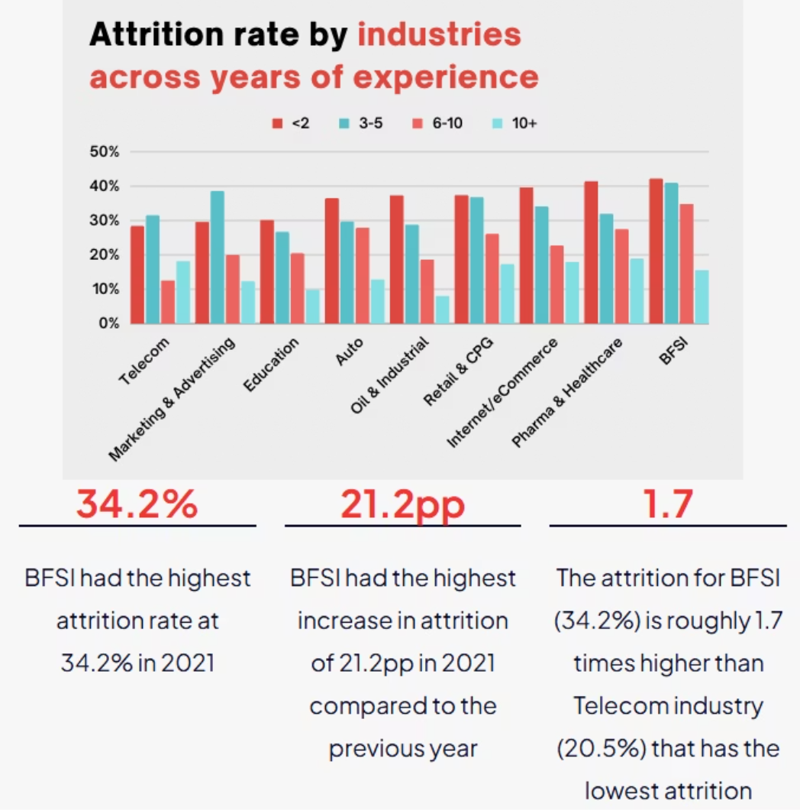
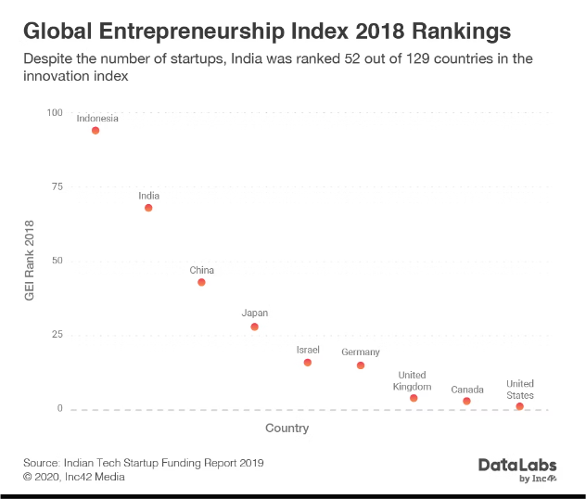
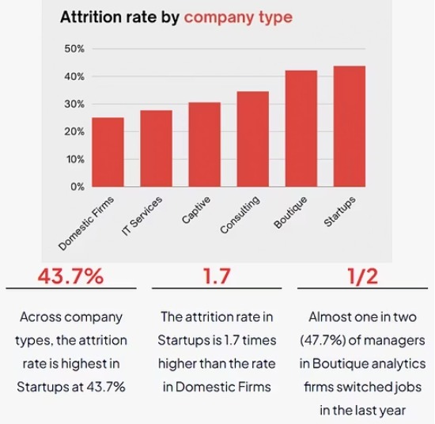
How KM gaps wreck startups
1
2
3
Tech Debt Explosion
Attrition Chaos
Investor Distrust
Especially seen across mid-sized Indian fintech firms where "extreme deadlines" and "no time to address tech‑debt" lead to messy sprints and repeated fix cycles. No backlog grooming, no specs, no code ownership—just continual firefighting.
The Indian IT-BPM industry, with attrition hitting 30%–40%, directly links staff turnover to lost institutional memory, project delays, and lower client satisfaction—a direct reflection of knowledge management failure.
At Infra.market, fraud slipped in through poorly documented financial oversight. One city head inflated rental expenses, and inventory teams earned off hidden commissions; investors had no visibility, pulling funding only after the damage surfaced.
Research from IMI Kolkata shows that firms with stronger R&D and ICT capabilities report significantly better innovation outcomes
Documenting and retaining knowledge isn't just a process issue — it fundamentally underpins the ability to conduct meaningful R&D. Without robust knowledge systems, startups fail to innovate, duplicating work, and reinforcing a cycle of underinvestment in true innovation.

Slide 4

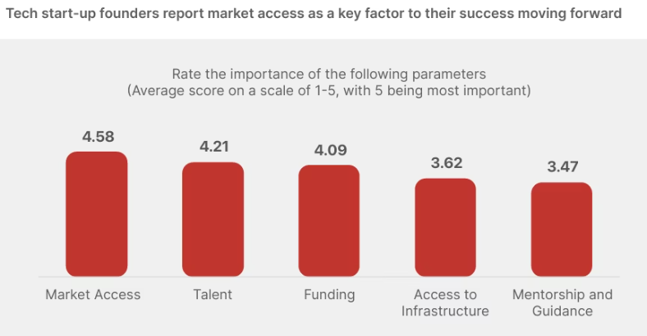



Why KM Gaps Persist (The Founder Mindset Trap)
Funding pressure pushes short-term gains
Under capital strain, founders chase burn rate and feature velocity, sidelining sustainable documentation. (Economic Times, 2023)
Fear of transparency
Founders hoard knowledge to retain power, often avoiding transparency and documentation to centralize decision-making. This lack of shared systems fosters dependency and hinders scaling, discouraging even proactive employees from documentation.
Founders undervalue information systems
Startup leaders often view KM as admin overhead and not as a strategic asset, and resist implementing platforms like Notion or Confluence, citing time constraints or lack of awareness.
High attrition is used to justify not documenting
Before:
High Attrition → Lost Knowledge → Inefficiency
With startup attrition skyrocketing—often 50–80%, and 30–40% in SaaS, every exit erases knowledge; each hiring cycle forces new hires to relearn processes.
After:
Strong KM → Retained Knowledge → Faster Scaling

Slide 5
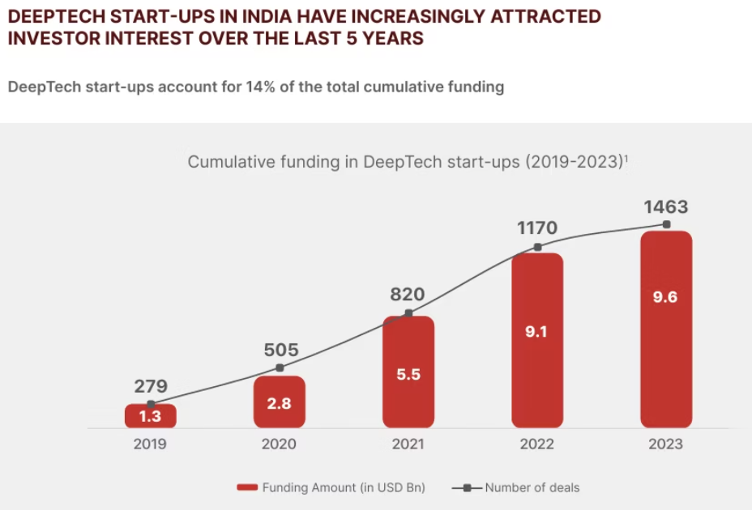
The Fix: How Top 1% Startups Crack KM
Structured KM in onboarding
Startups that embed structured documentation into onboarding processes reduce ramp-up time by 30–50%, significantly improving employee satisfaction and retention. Notion’s Indian-focused onboarding templates are credited with a 40% faster completion rate.
Centralized documentation
Boosts Innovation: Top startups use Notion, ClickUp, or Confluence to store insights, enabling faster iteration cycles. Example - Indian Deep-Tech startups investing in structured R&D documentation see higher patent filings, boosting innovation (see pic).
Clear financial documentation
Efficient workflows
Strengthens Investor Confidence: Investors favor startups with clear documentation of financials, reducing risk perception. Example - Poor KM led to BYJU’s financial mismanagement, causing auditor resignations and investor distrust.
Superior Unit Economics: Well-documented workflows reduce decision-making time, improving cost efficiency. Structured KM prevents scaling bottlenecks, ensuring consistent growth, higher valuations and smoother IPOs.

Slide 6
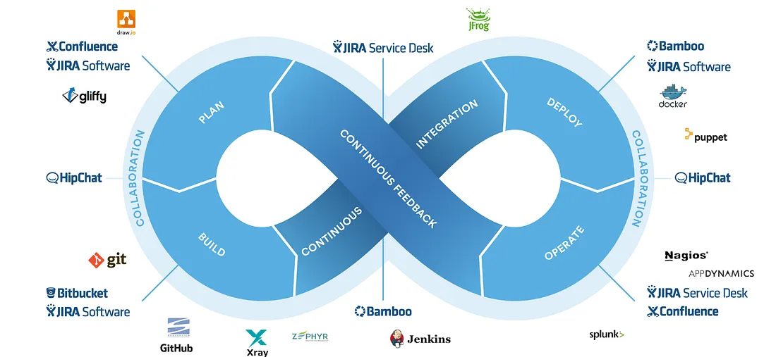





Call to Action: Proposing Actionable Solutions
Start doc culture early
Use Notion, ClickUp, or Confluence to centralize knowledge, ensuring easy access to past decisions, SOPs, and technical documentation.
Follow Standard Operating Procedures for scaling
NASSCOM recommends SOPs for hiring, onboarding, and decision-making to ensure consistency and efficiency, as startups with structured SOPs reduce onboarding time by 30-50%, improving retention.
Internal wiki/cross-team docs
Companies like Zoho host weekly "Team Knowledge Circles" where newly documented processes get consolidated through group discussions, reducing tribal knowledge loss.
Before KM Adoption:
Disorganized documentation → Repeated mistakes → Slow onboarding
CI/CD for Engineering efficiency
DevOps practitioners from Agile India advocate using CI/CD for “feature toggles” and auto-releasing system workflows—combining code and docs in the same release thread.
After KM Implementation:
Centralized knowledge → Faster decision-making → Retention boost

Slide 7
Thank You!

